Slide 1
Picocyanobacteria phylogenetic diversity in freshwater and coastal shelf environments
Trevor Tubbs

Slide 2
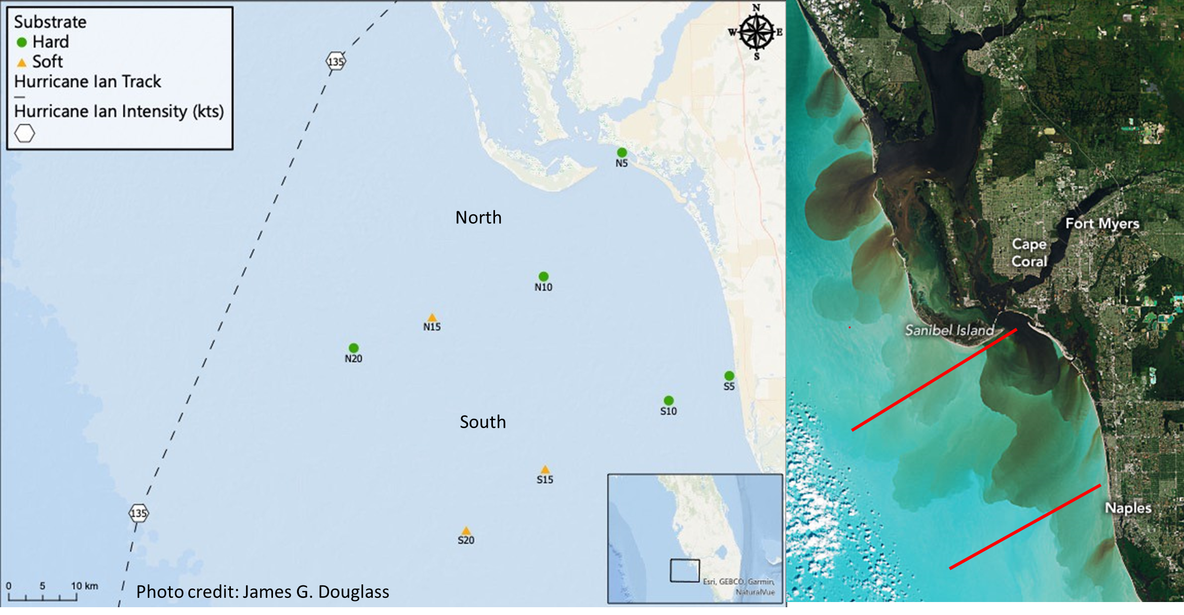
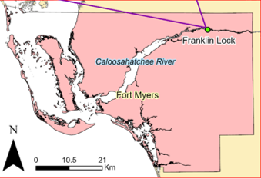
Introduction
Synechoccous spp. and Cyanobium spp. (picocyanobacteria) dominanates phytoplankton communities in Caloosahatchee river (Urakawa et al. 2023)
Goal: Track the influence the CR discharge to the coastal shelf with picocyanobacteria biogeography
Using single amplicon metagenomics

Slide 3
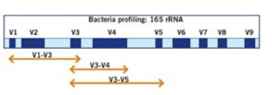
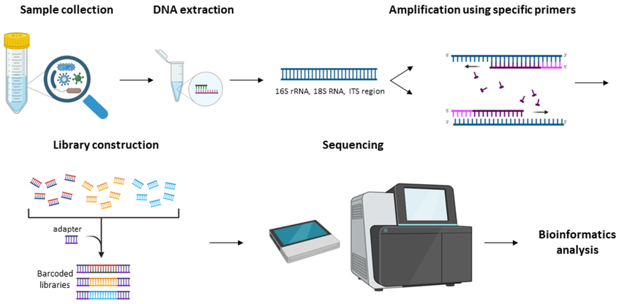
16S rRNA amplicon sequencing
Like Illumina sequencing but with a gene target is amplified through PCR
Primers target hypervariable regions of 16S rRNA gene which acts as a “barcode” to identify distinct organisms
End product is 1000-10,000 of ASVs with varying counts representing the microbial commuitiy
Amplicon sequence variant = unique nucleotide sequence representing a different species/strain

Slide 4
Methods
Qiime2 = ASV generation (Dada2) and Taxonomic Classification (Silva database)
Extracted ASV sequneces of f_Cynanobium →158 ASV
R package Phyloseq used to create relative abundance tables to remove less abundant ASVs →53 ASV
R package msa used with align sequences with MUSCLE
Phylogenetic tree constructed with RaxMLGUI 2.0
Maximum Likelihood Method
Model of sequence evolution: General Time Reversible
Visualized tree in R with ggtree

Slide 5
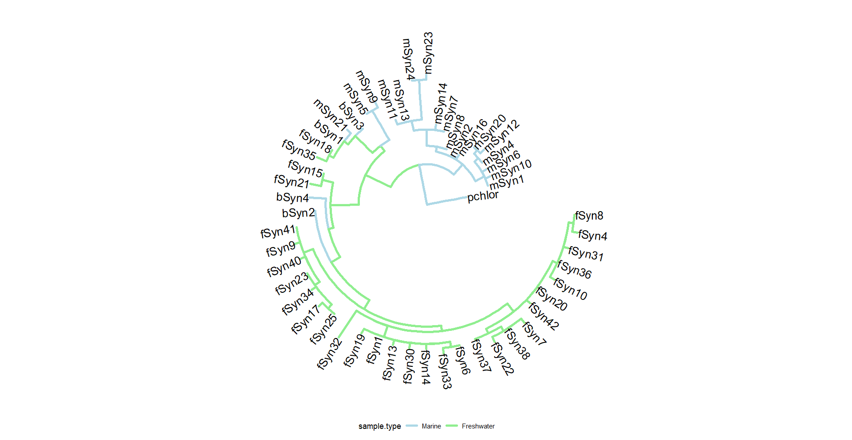
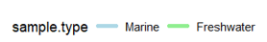
Taxonomic classification of picocyanobacteria not highly resolved
Blast results of rep seqs inconclusive
Add known Synechoccous strains from marine and freshwater environments
Marine Clade
Potential indicators: 16SrRNA Blast
bSyn1 =Synechococcus rubescens (96.37%)
bSyn2 = Cyanobium gracile (98.06%
bSyn3 = Synechococcus rubescens (96.61%)
bSyn4 = Synechococcus rubescens or Cyanobium gracile (97.34%)
Freshwater Clade

Slide 6
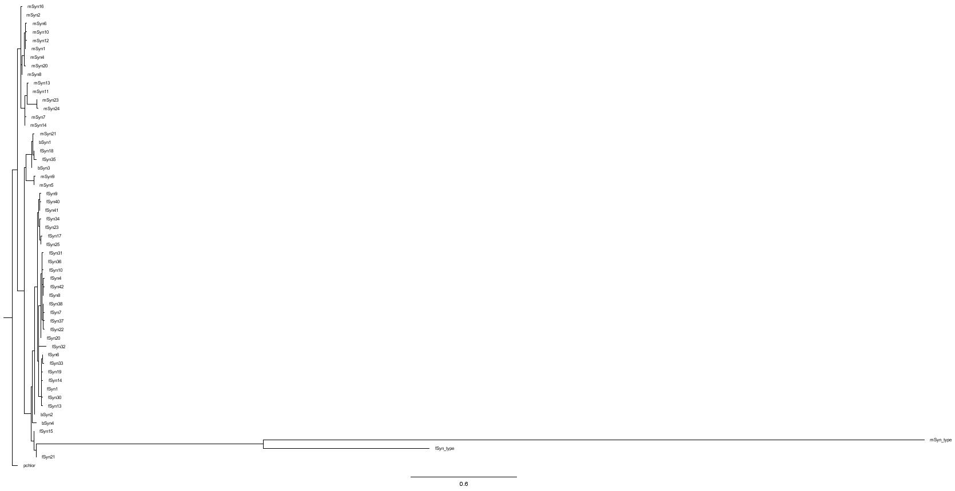
“Type” strains imbedded with freshwater clade but large distance
Likely due to differences in sequencing technology

Slide 7
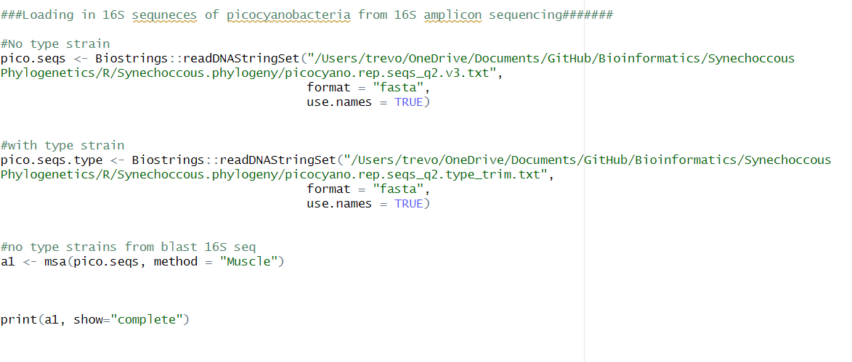
MSA Code

Slide 8
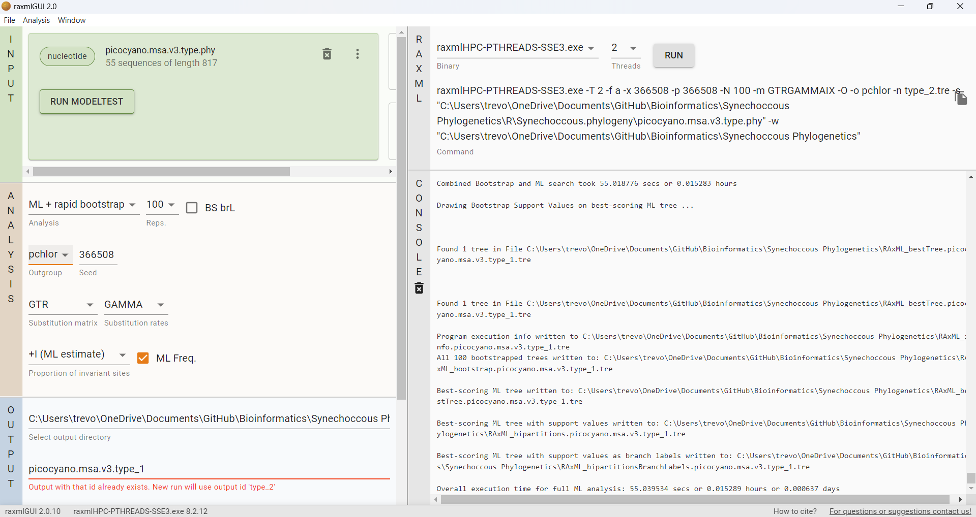
RaxMLGUI2.0

Slide 9
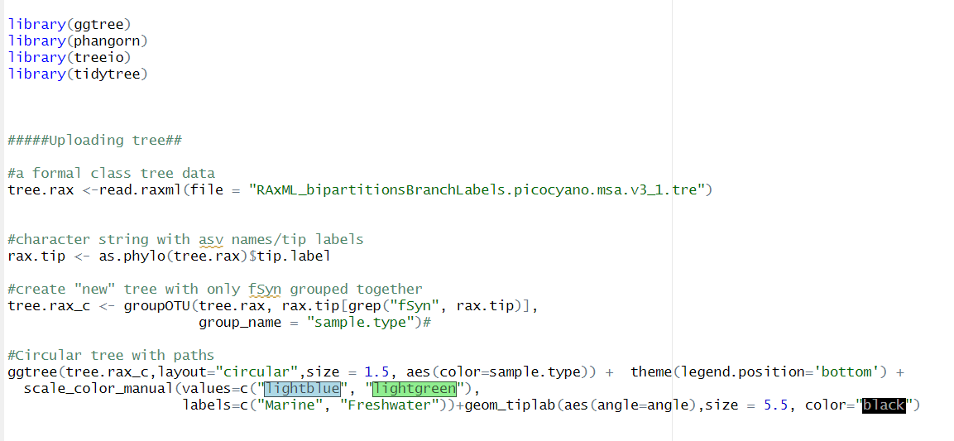
ggtree code

